Slide 1
Factorial
By : Assim Abdelnour Elbably

Slide 2
Introduction
Factorial Definition: the factorial of a a positive integer n , denoted by n!, is the product of all integers less than or equal to n. For example, the factorial of 4 is equal to 4*3*2*1= 21.
A factorial is the product of the natural number multiplied by each number in descending order. It can be any natural number. The factorial is represented in math by an exclamation point, usually following the base raised to a positive integer power

Slide 3
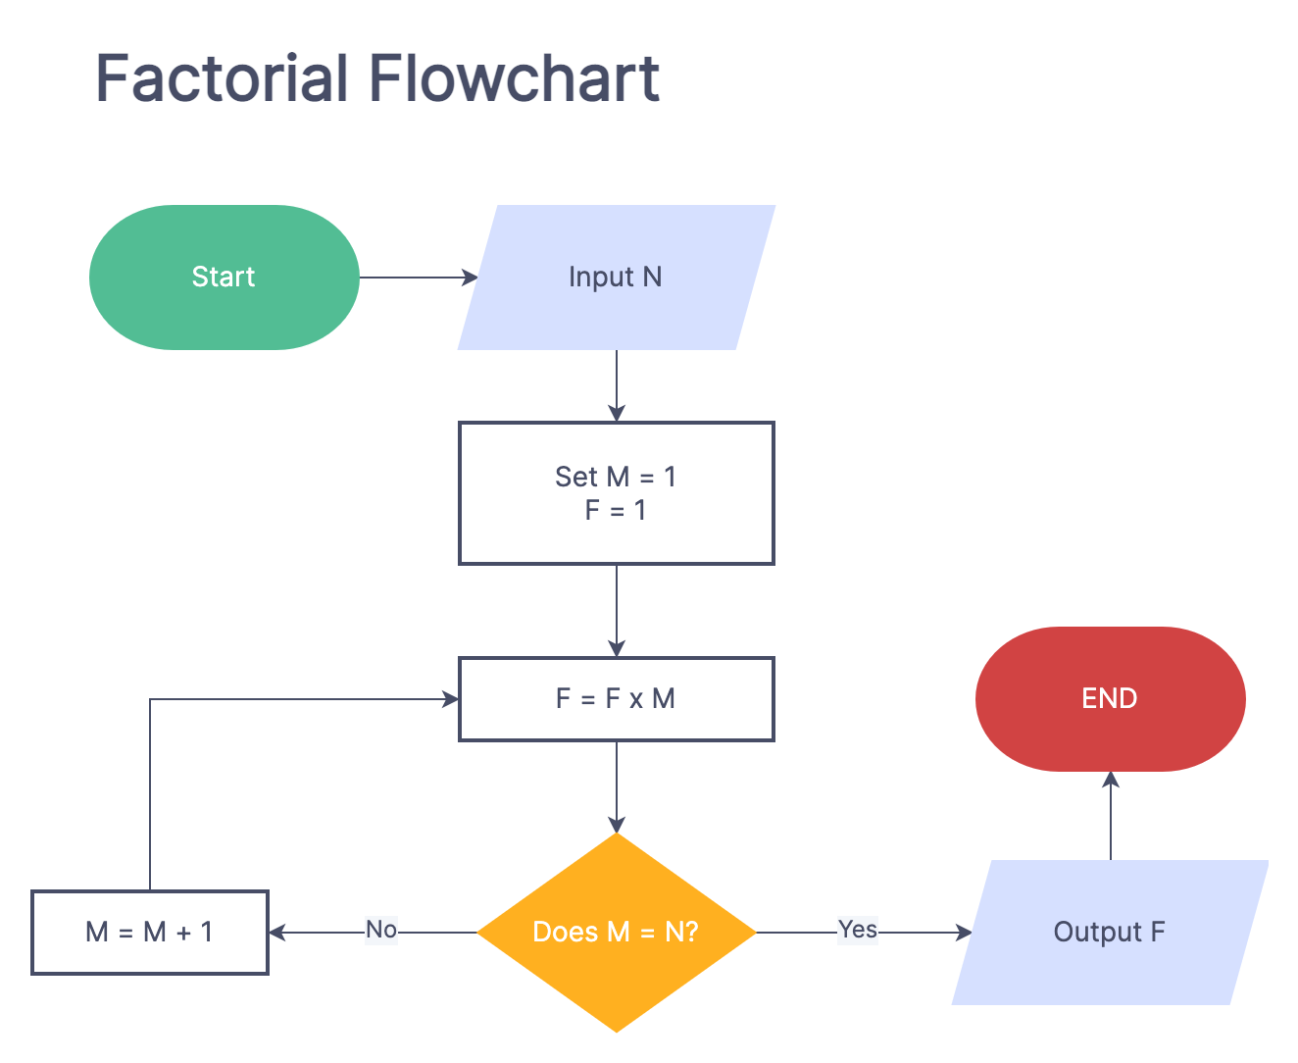
Factorial flowchart

Slide 4
Explain the code
.MODEL SMALL ; one data and one code
.STACK 10H ; the size of the stack in the program equal = 10H
.CODE
MAIN PROC FAR ; the start of program

Slide 5
Explain the code
MOV BH,0 ; move Zero to BH
MOV BL,10D ; move 10D (D for decimal) to BL
INPUT:
MOV AH,1
INT 21H ; make the user enter the value
CMP AL,13D ; compare if the AL = 13 or not if AL =13 we jump to FACT if not we jump to NUMBER
JNE NUMBER

Slide 6
Explain the code
AND CX,0 ; put in CX, Zero
MOV CL,BH ; move BH to C low
DEC CX ; make a decrement to CX to know if the AX=0 or no
AND AX,0
MOV AL,BH

Slide 7
Explain the code
NUMBER: ; if the AL =! 13
SUB AL,30H ; subtract from AL-30
MOV CL,AL ; move AL to CL
MOV AL,BH
MUL BL ; multiply BL
ADD AL,CL ; add AL,CL to increase 1
MOV BH,AL

Slide 8
Explain the code
FACT:
MUL CX ; multiply CX we use CX because loop in assembly we use CX
LOOP FACT
AND DX,0
MOV CX,10D ; is an instruction that sets the value of the CX register to 10D (decimal)
MOV BX,0000H ; is an instruction that sets the value of the BX register to 0000H (hexadecimal)

Slide 9
Explain the code
STORE:
DIV CX ;DX:AX / CX REM = DX ,,, QUE = AX
MOV [0000H+BX],DX ; It is used to move the contents of the memory location pointed to by the sum of the contents of the BX register and the 0000H memory location into the DX register.
ADD BX,2H
MOV DX,0
CMP AX,0
JNE STORE
MOV AH,2
MOV DL,0DH
INT 21H
MOV DL,0AH
INT 21H

Slide 10
Explain the code
PRINT:
SUB BX,2H
MOV DL,[0000H+BX]
ADD DL,30H
INT 21H
CMP BX,0
JNE PRINT
MAIN ENDP
END MAIN

Slide 11
SUMMARY
We use this code to know the factorial of the numbers
Between 1to8

Slide 12
THANK YOU

